Slide 1





VETERAN AND FAMILY SUPPORT
BY BONNIE RIGGS
DEPARTMENT CHAIRMAN
2026-2027

Slide 2
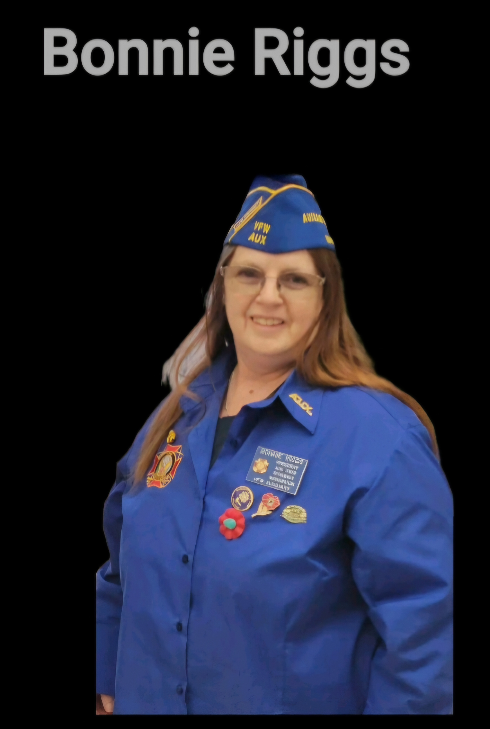
I AM YOUR NEW DEPARTMENT VETERAN AND FAMILY SUPPORT CHAIRMAN FOR 2026-2027
CONTACT INFORMATION
BONNIE RIGGS
DEPARTMENT VFS CHAIRMAN
briggs6012@gmail.com

Slide 3


FISHER HOUSE
I You or someone you love is receiving care at a VA or military medical center, check the list of Current Houses to see if there is a Fisher House that can help. Criteria to stay is established locally by the hospital or installation command so please contact the location with any questions. There is never a charge to stay at a Fisher House.
This Photo by Unknown Author is licensed under CC BY-NC-ND

Slide 4



Slide 5

MAP PROGRAM INFORMATION

Slide 6
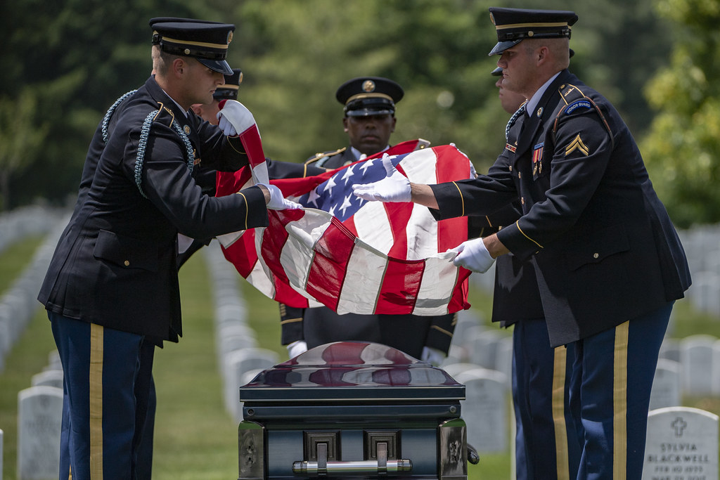
SEPTEMBER IS SUICIDE PREVENTION
MONTH

Slide 7


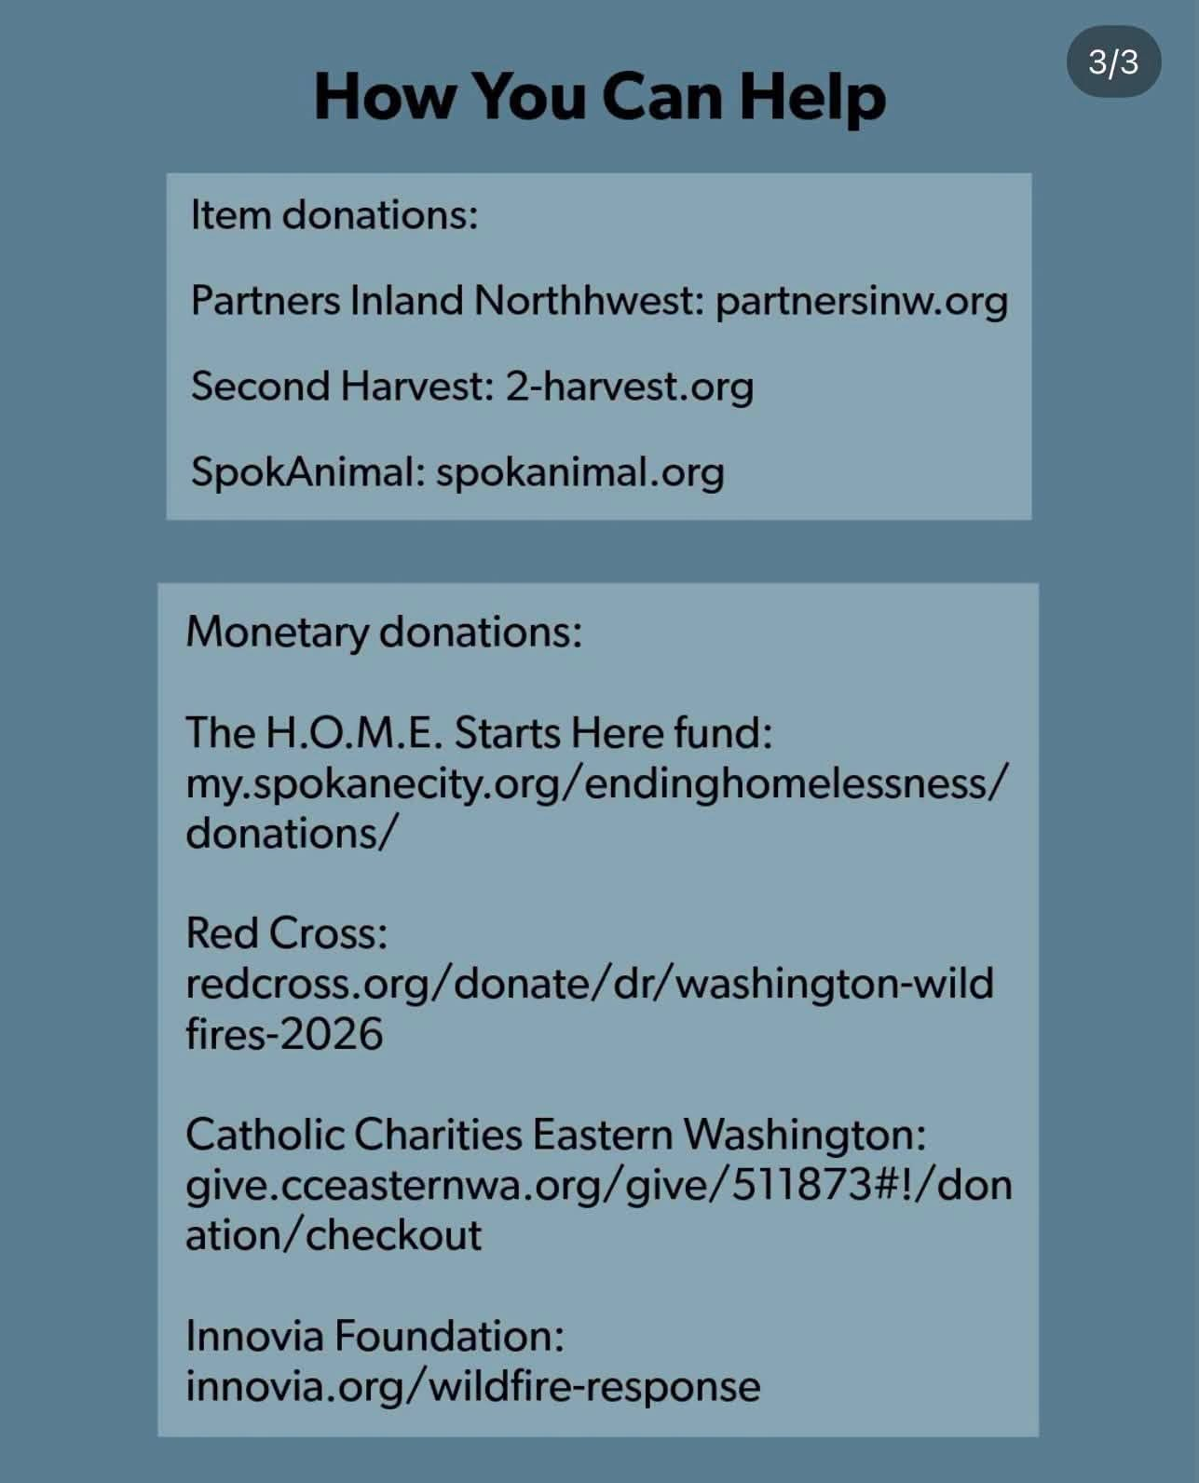
HELPING OUR VETERANS AND THEIR FAMILIES
FROM THE FIRE DISASTERS IN SPOKANE

Slide 8
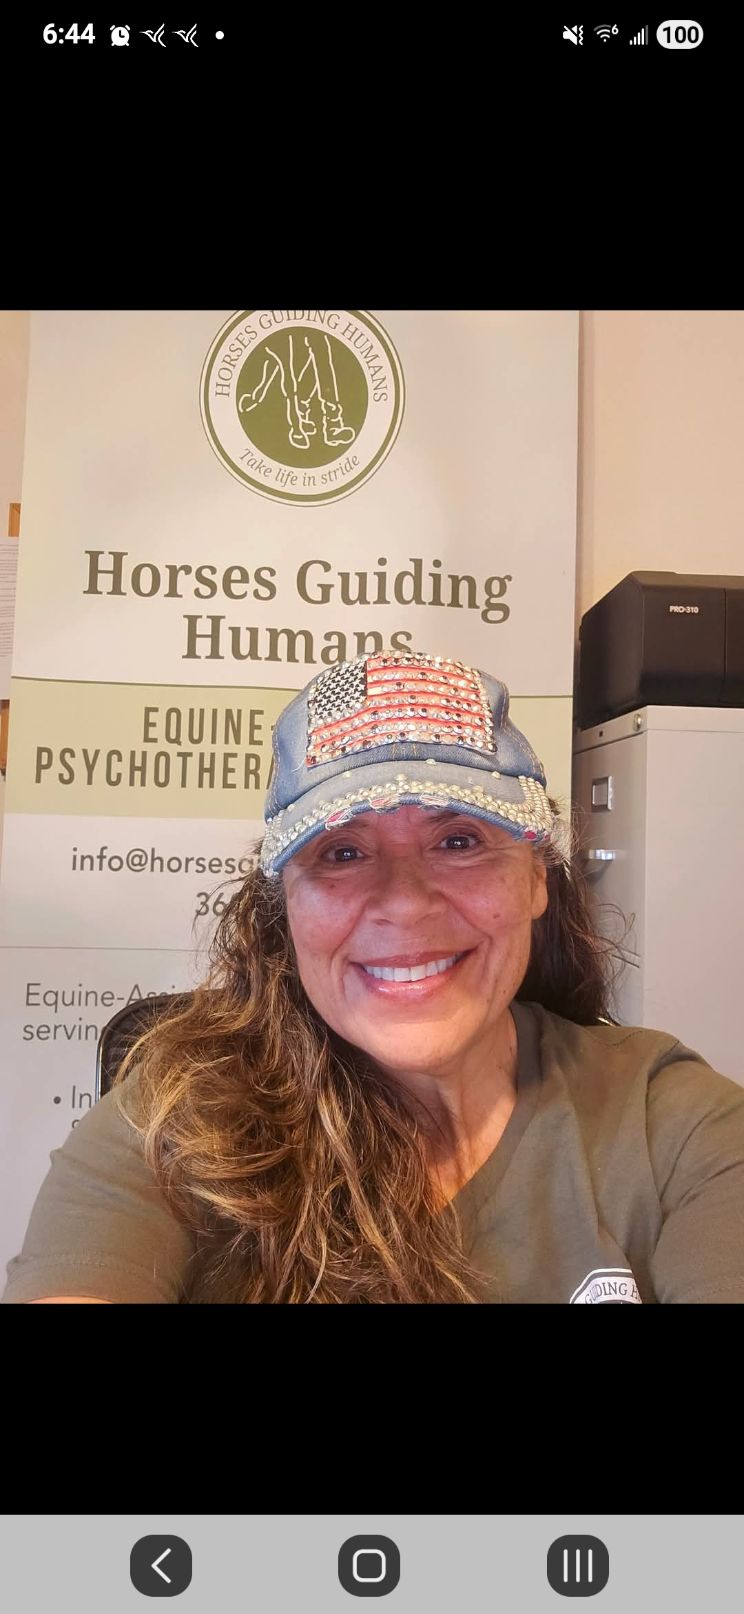
NEW SPECIAL PROGRAMS FOR
2026-2027
DONATIONS CAN BE MADE ONLINE OR MAIL. vfw.org/ways-to-help
VETERAN CRISIS LINE: VETERANS & THEIR FAMILY, CAN DIAL #988 THEN DIAL-1 OR TEXT #838255 TO RECEIVE CONFIDENTIAL SUPPORT 24/7
MENTAL HELP SUPPORT WEBSITE https://www.vfw.org/assistance/mental-wellness
HELPING SPOKANE FIRE VICTIUMS AND EVACCUATED.
NEED FOOD, CLOTHING,
HORSES GUIDING HUMANS WITH PTSD THERIPY
LINDA ARSONALT

Slide 9
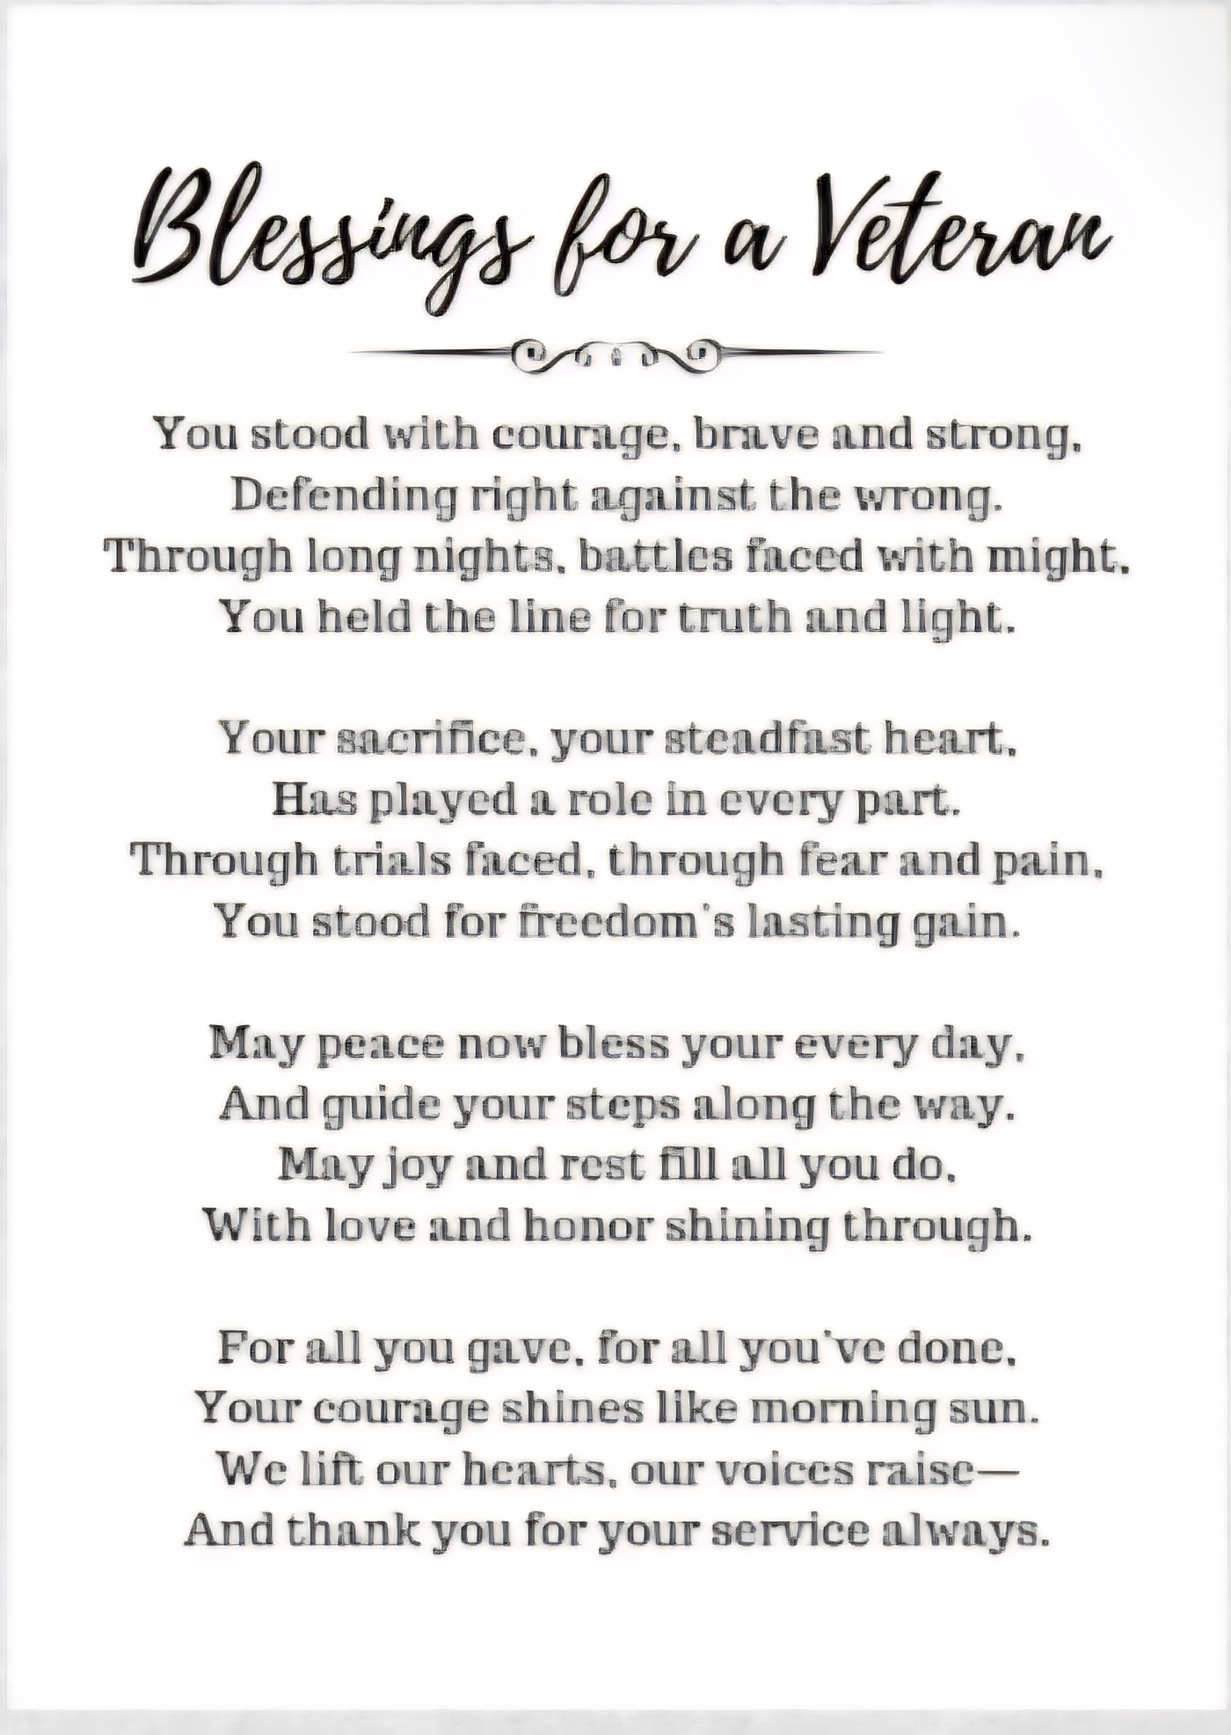


Slide 10
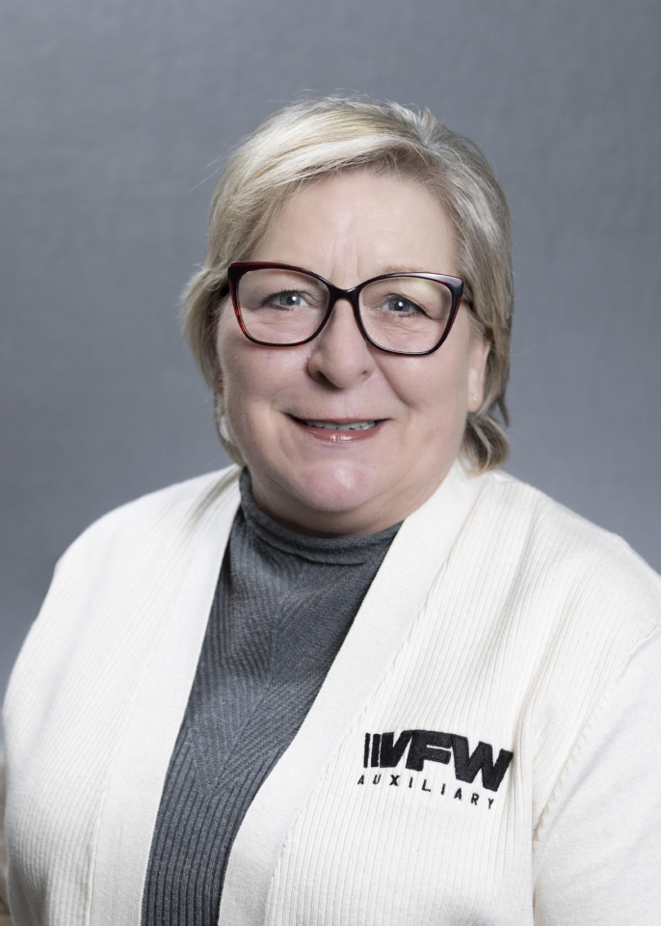
DEPARTMENT AUXILIARY PRESIDENT’S SPECIAL PROJECT FOR 2026-2027
"Hold On, Be Strong – Suicide Awareness,“
partnering with the Permission to Start Dreaming (PTSD) Foundation based in Gig Harbor, Washington. [1]
www.ptsdfoundation.org.

Slide 11

Frank Persa, Department Commander
Veterans of Foreign Wars Department of Washington 2026-2027
A Hero's Promise
Why This Project Matters
A Hero's Promise is a Washington-based veteran organization whose mission speaks directly to one of the greatest challenges many veterans face after service: finding connection, purpose, and belonging.
The military gives us a mission, a team, and a sense of purpose. When service ends, many veterans struggle to find those same connections in civilian life. Too often, veterans become isolated, disconnected, or unsure where they fit in.
More Than Support
What makes A Hero's Promise unique is that they do more than provide support. They help veterans discover what brings them joy and reconnects them with life.
If a veteran is interested in fishing but has never had the opportunity, A Hero's Promise helps get them on the water. If that veteran discovers they enjoy it, the organization connects them with a veteran group that regularly participates in fishing activities.
sports, outdoor recreation, and many other interests. The same concept applies to hunting, hiking, camping, shooting

Slide 12


VFW & AUXILIARY PROGRAMS FOR VETERANS AND FAMILY SUPPORT
MILITARY ASSISTANCE PROGRAM
FISHER HOUSE
UNMET NEEDS
https://www.va.gov › puget-sound-health-careAmerican Lake VA Medical Center | VA Puget Sound Health ...
“The love of a family, is life’s greatest blessing”
SPORTS CLIPS
NATIONAL HOME FOR CHILDREN

Slide 13


CONTACT ME FOR
VETERANS AND FAMILY SUPPORT
DEPARTMENT CHAIRMAN 2026-2027
BONNIE RIGGS
briggs6012@gmail.com
PS. PLEASE SEND YOUR YEAR END REPORT BY APRIL 1ST. 2027

Slide 14
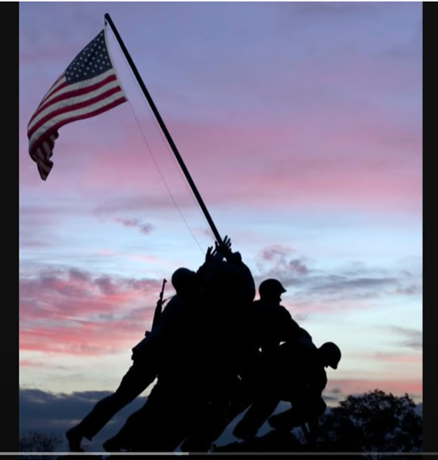
MUSIC BY: https://www.youtube.com/watch?v=-KoXt9pZLGM
Lee Greenwood
GOD BLESS THE USA

